Slide 1

Recurrent Neural Network (RNN)
Raghu Prasad Konandur
9845547471
www.kaushalya.tech
raghuprasadkonandur@kaushalya.tech

Slide 2
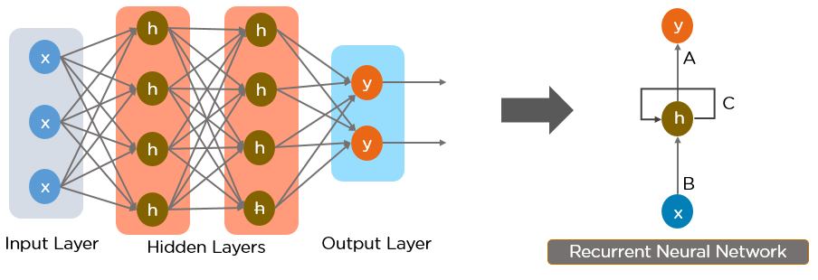
What is RNN
RNN works on the principle of saving the output of a particular layer and feeding this back to the input in order to predict the output of the layer.
Below is how you can convert a Feed-Forward Neural Network into a Recurrent Neural Network:

Slide 3
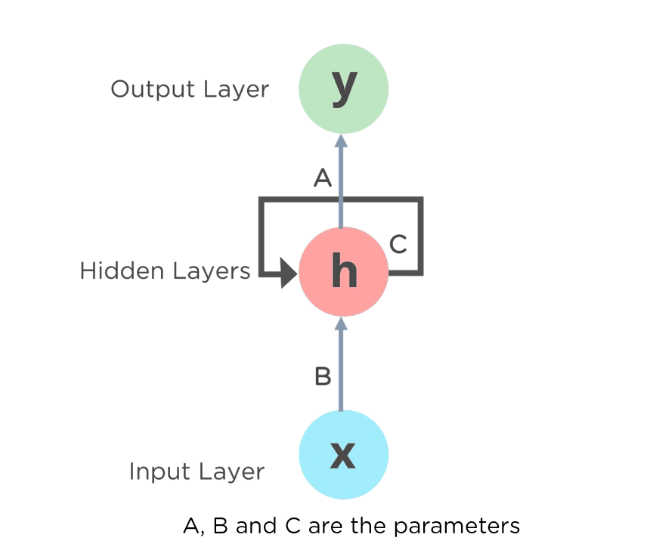
What is RNN
The nodes in different layers of the neural network are compressed to form a single layer of recurrent neural networks. A, B, and C are the parameters of the network.Fully Connected RNN

Slide 4
What is RNN
The nodes in different layers of the neural network are compressed to form a single layer of recurrent neural networks. A, B, and C are the parameters of the network.Fully Connected RNN

Slide 5

What is RNN
Here, “x” is the input layer, “h” is the hidden layer, and “y” is the output layer. A, B, and C are the network parameters used to improve the output of the model. At any given time t, the current input is a combination of input at x(t) and x(t-1). The output at any given time is fetched back to the network to improve on the output.

Slide 6
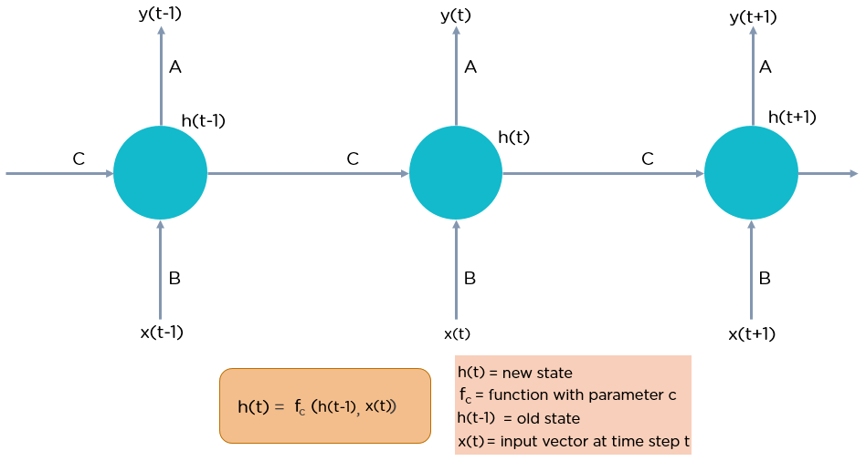
What is RNN

Slide 7
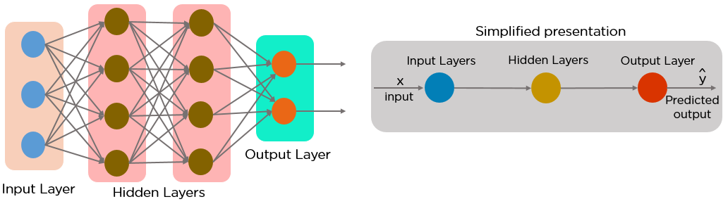
Types of RNN
A feed-forward neural network allows information to flow only in the forward direction, from the input nodes, through the hidden layers, and to the output nodes. There are no cycles or loops in the network.
Below is how a simplified presentation of a feed-forward neural network looks like:

Slide 8
Why Recurrent Neural Networks?
RNN were created because there were a few issues in the feed-forward neural network:
Cannot handle sequential data
Considers only the current input
Cannot memorize previous inputs
The solution to these issues is the RNN. An RNN can handle sequential data, accepting the current input data, and previously received inputs. RNNs can memorize previous inputs due to their internal memory.

Slide 9
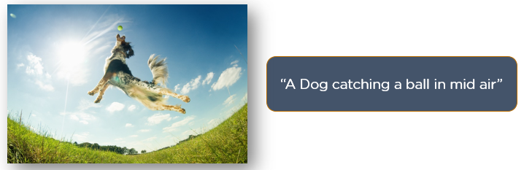
Applications of RNN
Image Captioning
RNNs are used to caption an image by analyzing the activities present.

Slide 10
Applications of RNN
Time Series Prediction
Any time series problem, like predicting the prices of stocks in a particular month, can be solved using an RNN.
Natural Language Processing
Text mining and Sentiment analysis can be carried out using an RNN for Natural Language Processing (NLP).
Machine Translation
Given an input in one language, RNNs can be used to translate the input into different languages as output.

Slide 11
Types of RNN
There are four types of Recurrent Neural Networks:
One to One
One to Many
Many to One
Many to Many
One to One RNN
This type of neural network is known as the Vanilla Neural Network. It's used for general machine learning problems, which has a single input and a single output.

Slide 12
Types of RNN
One to One RNN
This type of neural network is known as the Vanilla Neural Network. It's used for general machine learning problems, which has a single input and a single output.
One to Many RNN
This type of neural network has a single input and multiple outputs. An example of this is the image caption.

Slide 13
Types of RNN
Many to One RNN
This RNN takes a sequence of inputs and generates a single output. Sentiment analysis is a good example of this kind of network where a given sentence can be classified as expressing positive or negative sentiments.
Many to Many RNN
This RNN takes a sequence of inputs and generates a sequence of outputs. Machine translation is one of the examples.

Slide 14
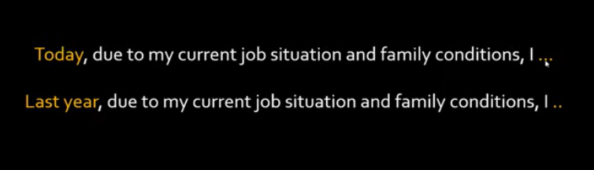
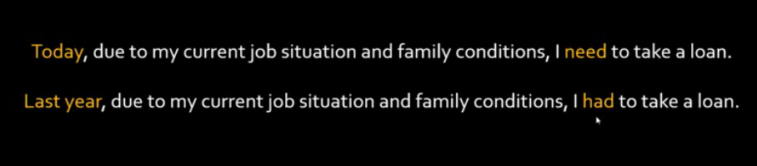
Long Short Term Memory (LSTM)

Slide 15
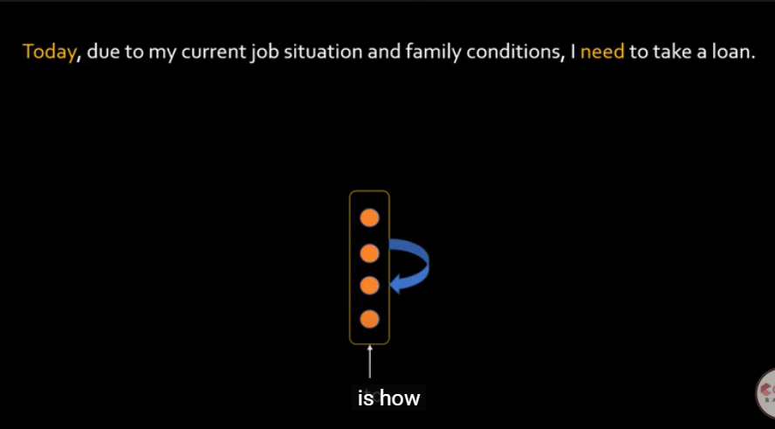
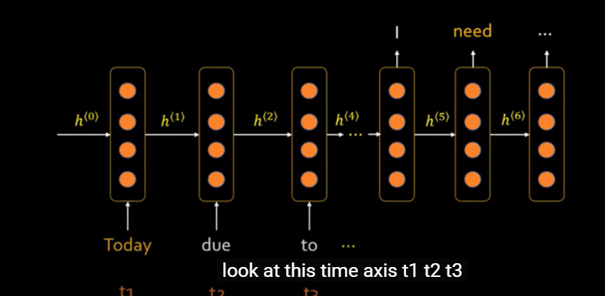
Long Short Term Memory (LSTM)

Slide 16
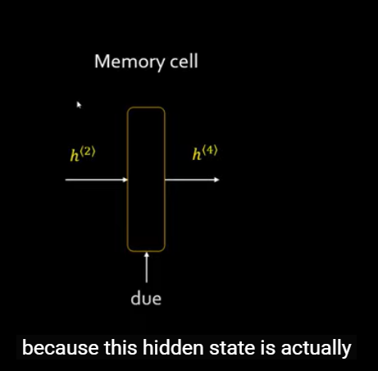
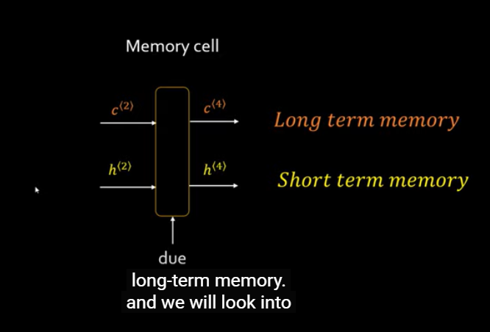
Long Short Term Memory (LSTM)

Slide 17
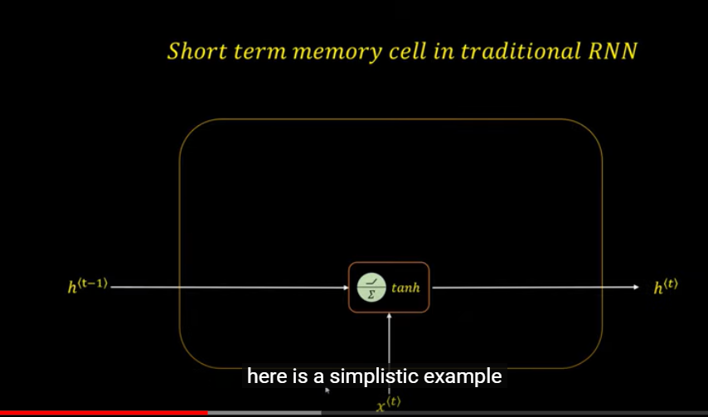
Long Short Term Memory (LSTM)

Slide 18
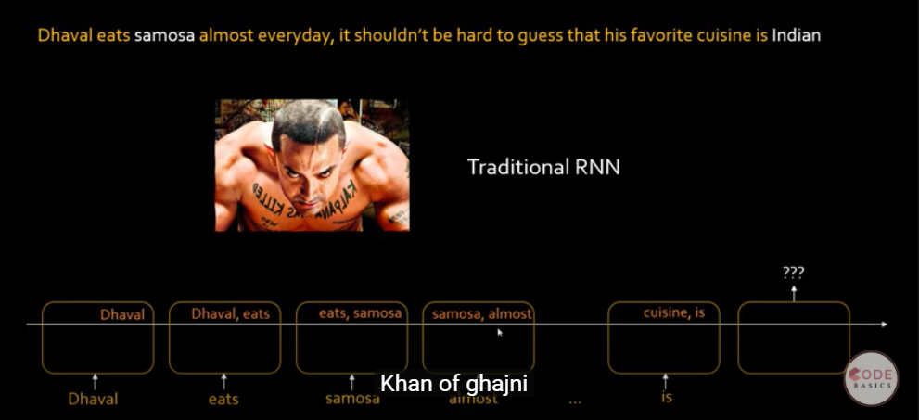
Long Short Term Memory (LSTM)

Slide 19
Long Short Term Memory (LSTM)

Slide 20
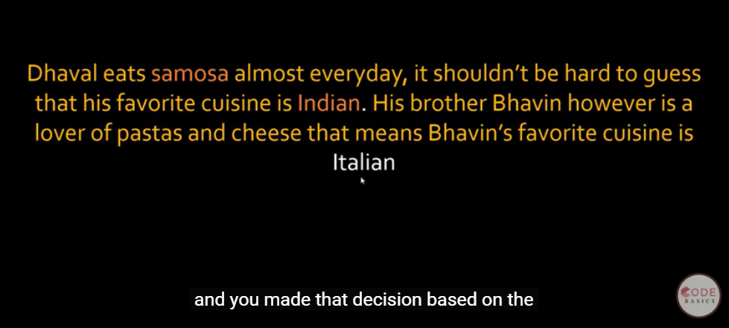
Long Short Term Memory (LSTM)

Slide 21
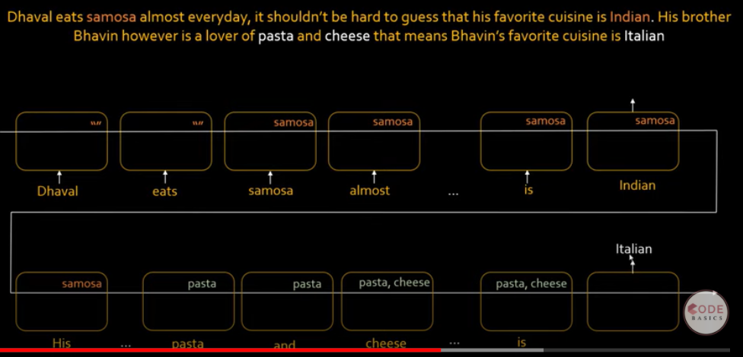
Long Short Term Memory (LSTM)

Slide 22
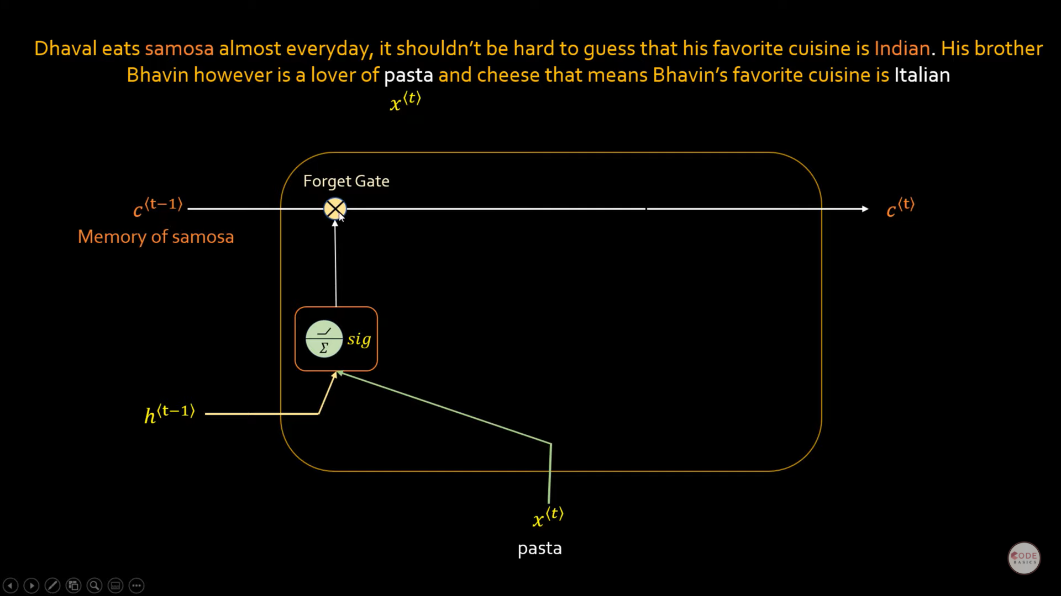
Long Short Term Memory (LSTM)

Slide 23
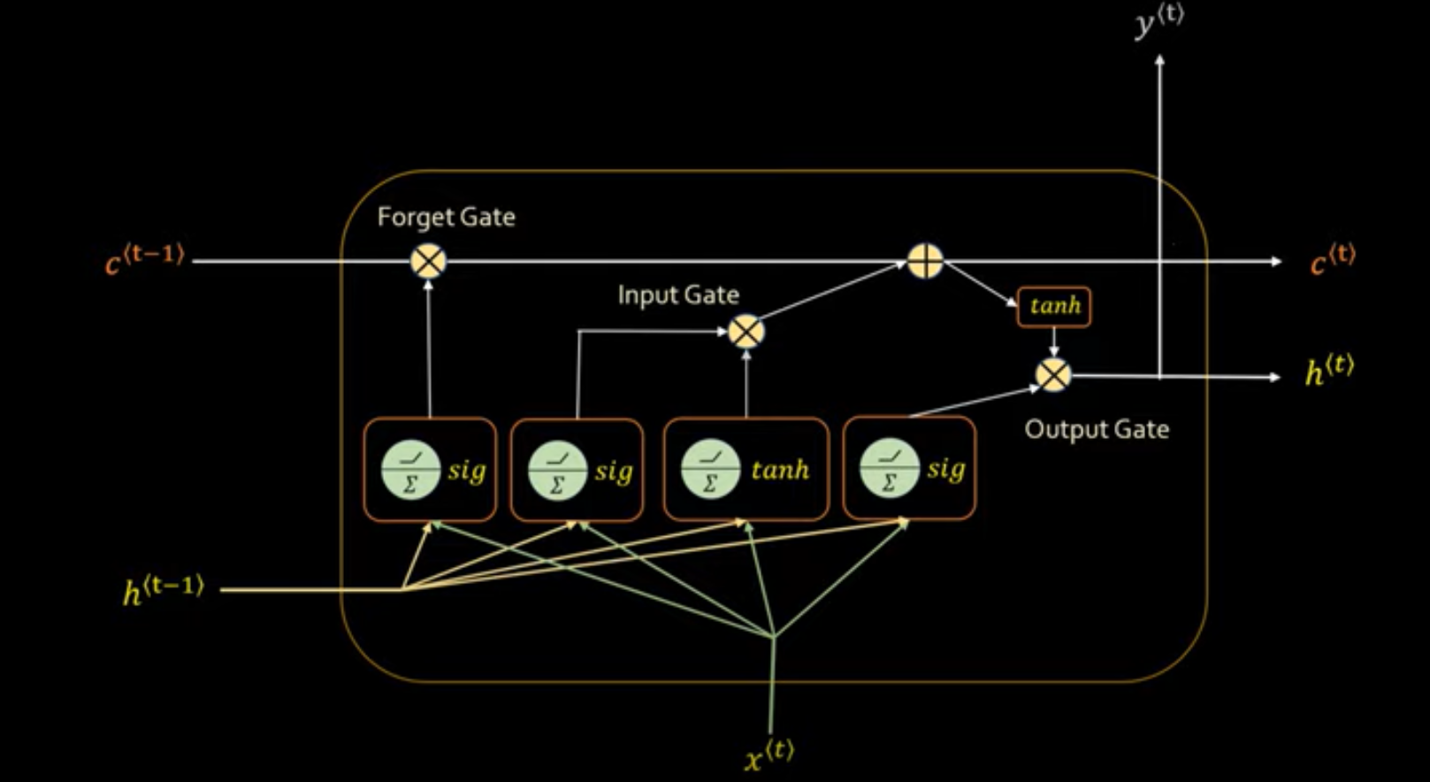
Long Short Term Memory (LSTM)

Slide 24

Long Short Term Memory (LSTM)

Slide 25
Thank You
Raghu Prasad Konandur
9845547471
www.kaushalya.tech
raghuprasadkonandur@kaushalya.tech

